Slide 1
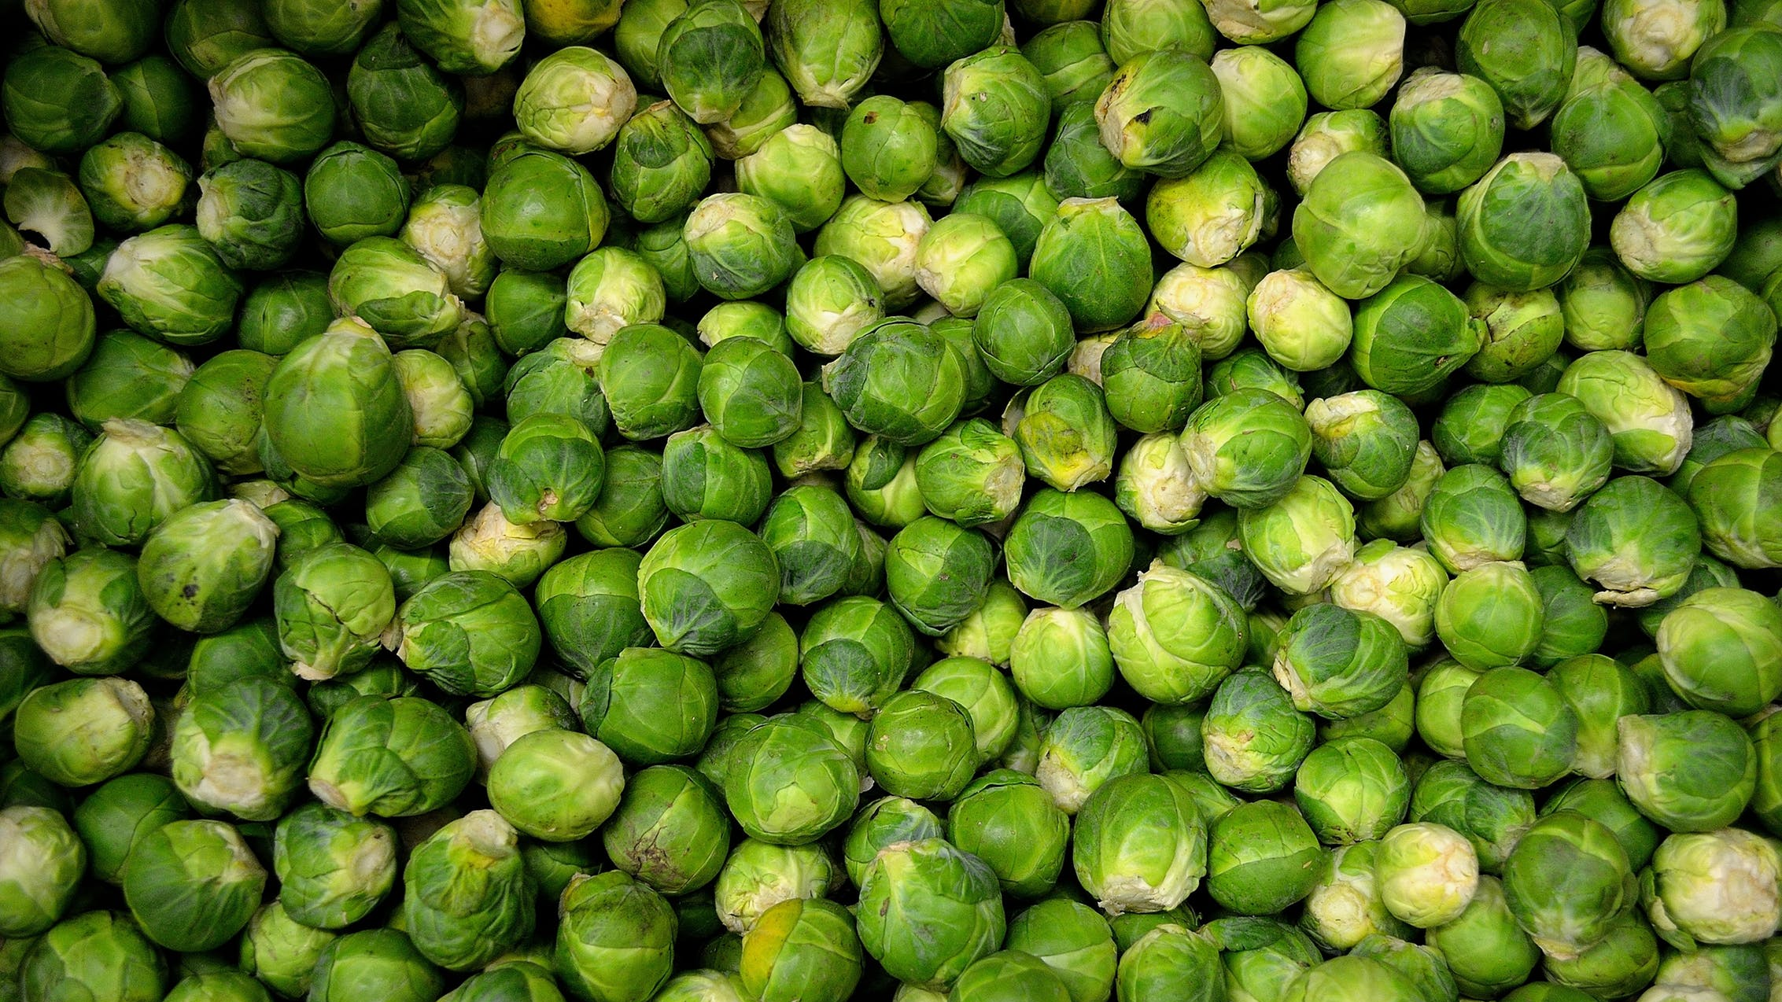

Transforming existing sites to the modern experiences
#SPSBE
Bert Jansen | @O365Bert
SharePoint Saturday Belgium 2019

Slide 3

Today’s agenda
Modernization overview
Demo
Planned investments
Q&A

Slide 4

aka.ms/sppnp-modernize

Slide 5

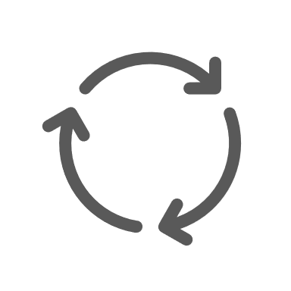

How to modernize SharePoint sites?
Develop SPFX based customizations
Get the most out of the modern list and library experience
Group connect your sites, teamify and use other group services
Workflow
InfoPath
Modernize your classic wiki, webpart and blog pages
Transform your classic publishing portals in modern communication sites
Use modern branding (tenant themes)

Slide 6


Why modernization tools?
Analyze
Customers don’t just adapt our latest features ➔ Why
Customers not always know their environment details
➔ What
Modernize
Learn
Customers do require automation to help adopt our latest features
➔ How
Modernization helps you stay “current”

Slide 7
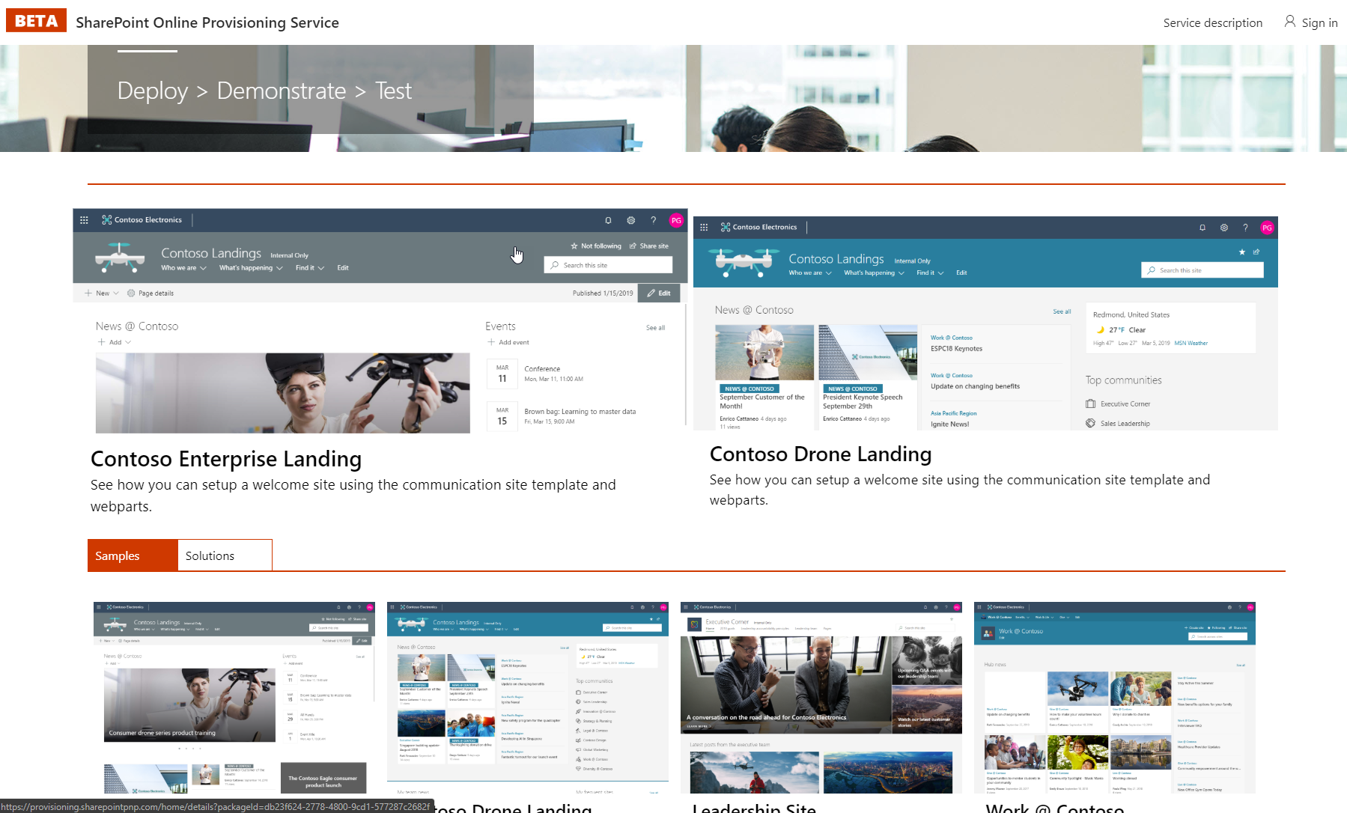
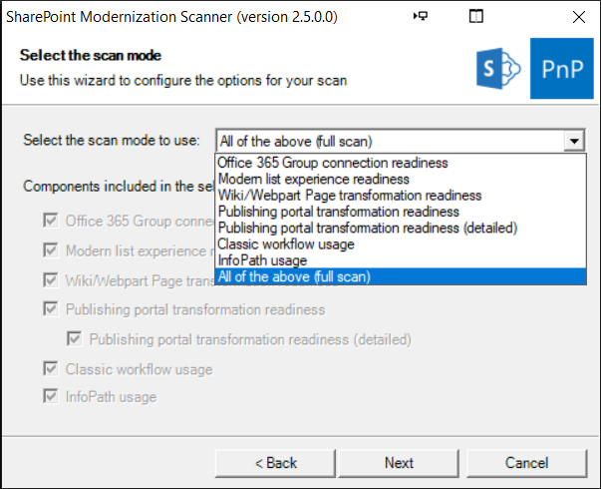
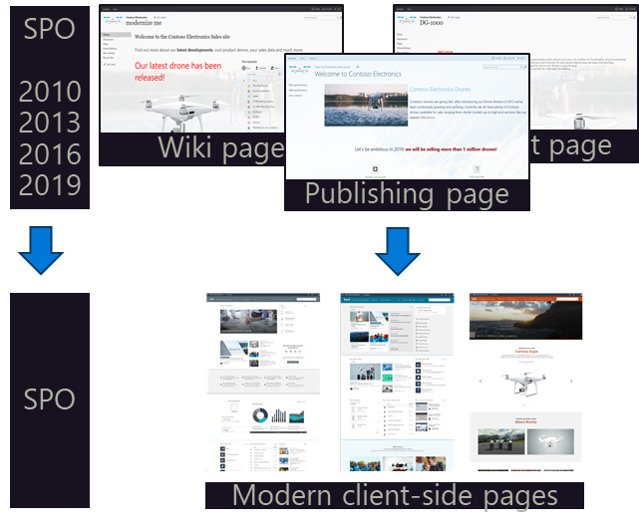
Learn
Analyze
Modernize
Available today
Available today
Available today (*)
Look Book
PnP Provisioning Portal
Look book sites
M365 Learning Pathways
Modernization scanner
Lists & Libraries
Group Connect
Pages
Publishing portals
Workflow (beta)
InfoPath (beta)
Bulk group connect
Page transformation
Wiki pages
WebPart pages
Publishing pages
Blog pages
Also from on-premises
(*) Excluding in product features

Slide 8

Is classic going away?

Slide 9

DEMO
Modernization

Slide 10

Learn
Analyze
Modernize
Look Book
PnP Provisioning Portal
Look book sites
M365 Learning Pathways
Modernization scanner
Lists & Libraries
Group Connect
Pages
Publishing portals
Workflow (beta)
InfoPath (beta)
Bulk group connect
Page transformation
Wiki pages
WebPart pages
Publishing pages
Blog pages
Also from on-premises
Roadmap
Roadmap
Roadmap
PnP Provisioning portal UI upgrade
Look book v2 sites
Modern Envisioning workshop
Modern success case studies
More workflow and InfoPath details
Classic blog usage scanning
Improved support for transforming from SharePoint on-premises
Portal modernization kit
Running modernization as a service (early thinking)

Slide 11

Stop further growing your modernization debt

Slide 12

Start modernizing where it makes sense

Slide 13

Start your modernization journey today

Slide 14


Resources
Modernization home: https://aka.ms/sppnp-modernize
Page transformation home: https://aka.ms/sppnp-pagetransformation
Page transformation videos: https://aka.ms/sppnp-pagetransformationvideos
Modernization scanner: https://aka.ms/sppnp-modernizationscanner
PnP Provisioning Portal: https://provisioning.sharepointpnp.com
Look Book: https://sharepointlookbook.azurewebsites.net/

Slide 15


http://spsbe.be
#SPSBE
Please rate this session!

Slide 16

#SPSBE
SharePoint Saturday Belgium 2019

